Slide 1
Lecture 2-2
Independent Cascade Model
and Linear Threshold Model
  Ding-Zhu Du
  University of Texas at Dallas

Slide 2
Independent Cascade (IC) Model
When node v becomes active, it has a single chance of activating each currently inactive neighbor w.
The activation attempt succeeds with probability p_{vw} .
The deterministic model is a special case of IC model. In this case, p_{vw} =1 for all (v,w).
Notes:
We again start with an initial set of active nodes A0, and the process unfolds in discrete steps according to
the following randomized rule. When node v first becomes active
in step t, it is given a single chance to activate each currently inactive
neighbor w; it succeeds with a probability pv;w —a parameter
of the system — independently of the history thus far. (If w has
multiple newly activated neighbors, their attempts are sequenced in
an arbitrary order.) If v succeeds, then w will become active in step
t+1; but whether or not v succeeds, it cannot make any further attempts
to activate w in subsequent rounds. Again, the process runs
until no more activations are possible.

Slide 3

Example
0.6
Y
Inactive Node
0.3
0.2
0.2
Active Node
X
U
Newly active
node
0.1
0.4
Successful
attempt
0.5
0.3
0.2
Unsuccessful
attempt
w
0.5
v
Stop!

Slide 4
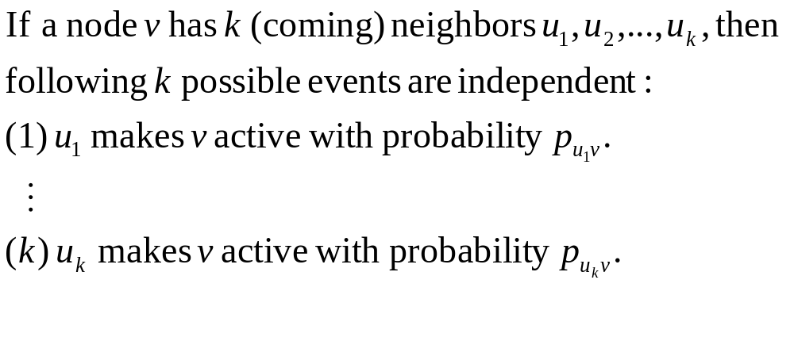




Independent Cascade (IC)

Slide 5

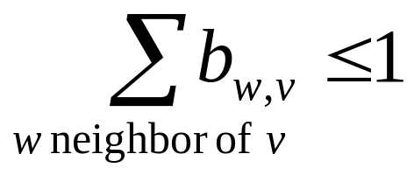

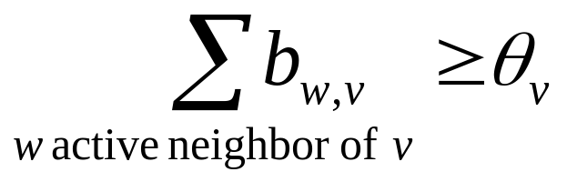
Linear Threshold (LT) Model
A node v has random threshold ~ U[0,1]
A node v is influenced by each neighbor w according to a weight b_{w,v} such that
A node v becomes active when at least
(weighted) fraction of its neighbors are active
Notes:
Given a random choice of thresholds, and an initial set of
active nodes A0 (with all other nodes inactive), the diffusion process
unfolds deterministically in discrete steps: in step t, all nodes
that were active in step t-1 remain active, and we activate any
node v for which the total weight of its active neighbors is at least
Theta(v)

Slide 6
Example
Y
Inactive Node
0.6
Active Node
0.3
0.2
0.2
Threshold
X
Active neighbors
0.1
0.4
U
0.5
0.3
Stop!
0.2
w
0.5
v

Slide 7
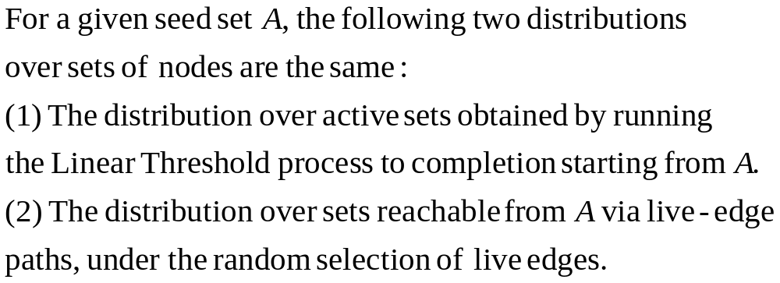
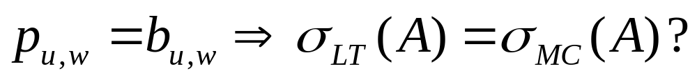
A property

Slide 8
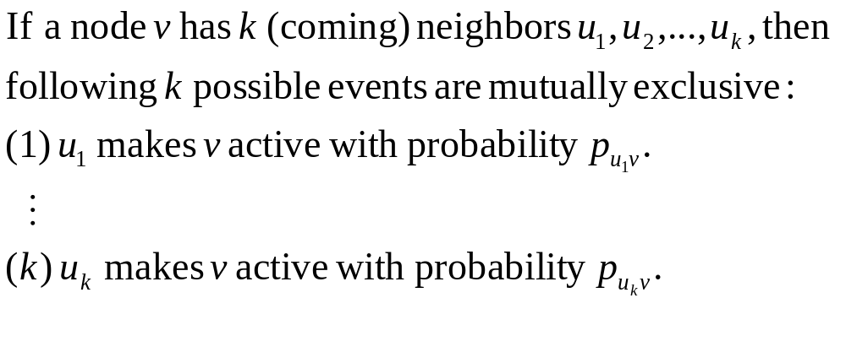
Mutually-exclusive Cascade (MC)

Slide 9
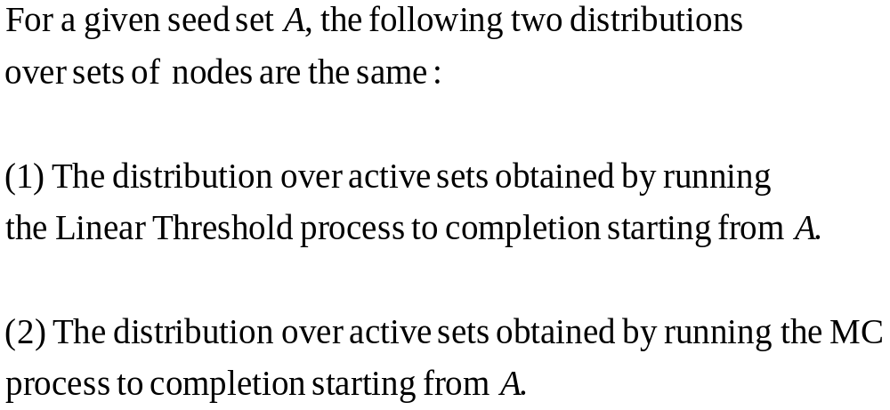
Theorem
Proof

Slide 10

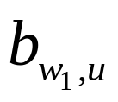

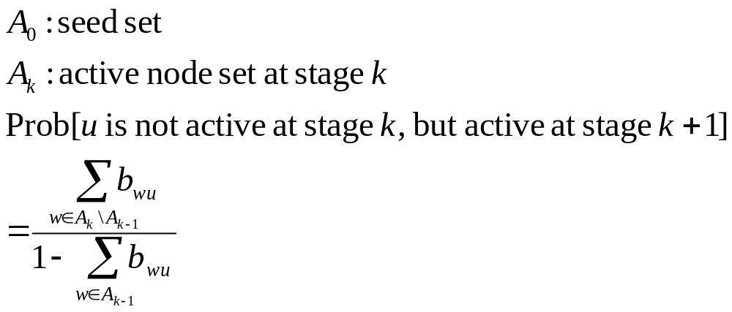

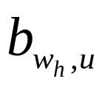
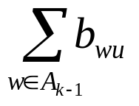


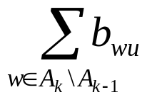
In LT Model

Slide 11

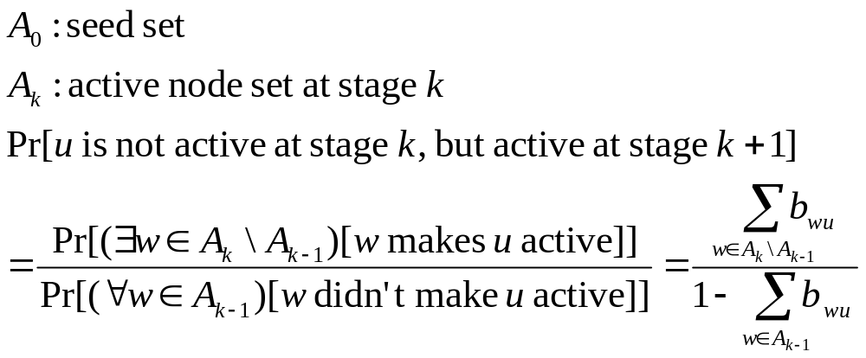
In MC Model

Slide 12
Mutually-exclusive Cascade (MC)

Slide 13
Examples

Slide 14
1st Example
difference between IC and LT

Slide 15

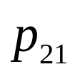
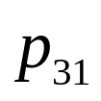
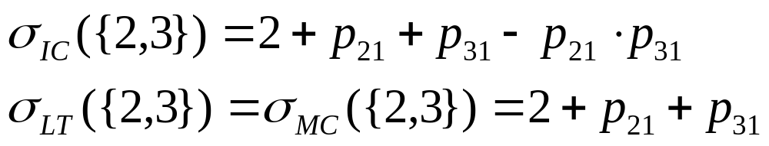
1
2
3

Slide 16
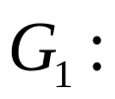

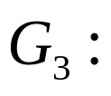
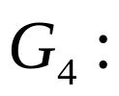
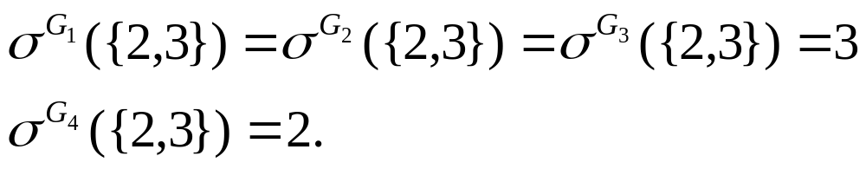
1
1
2
3
2
3
1
1
2
3
2
3

Slide 17
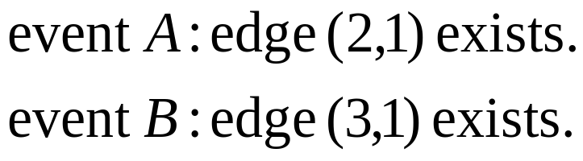
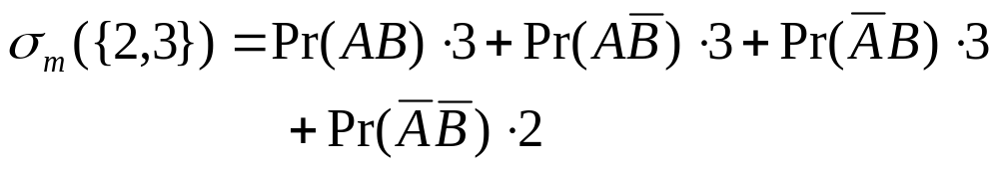
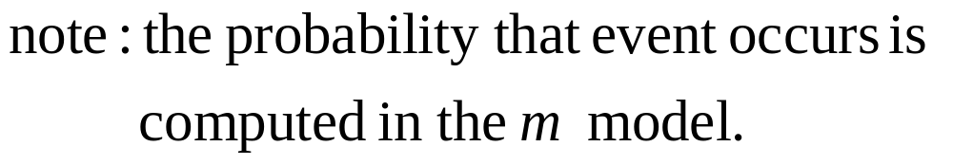
1
2
3

Slide 18
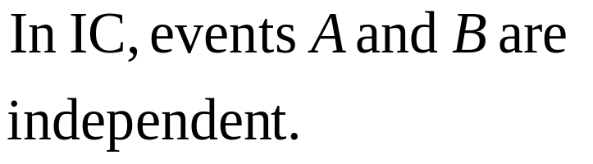
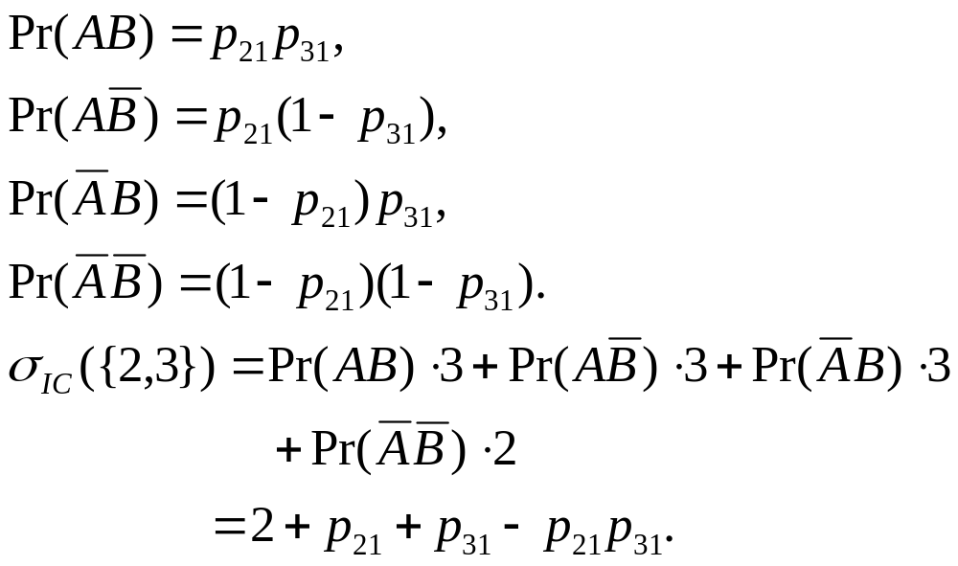
1
2
3

Slide 19
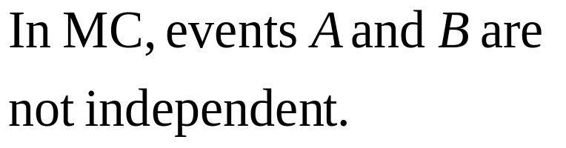
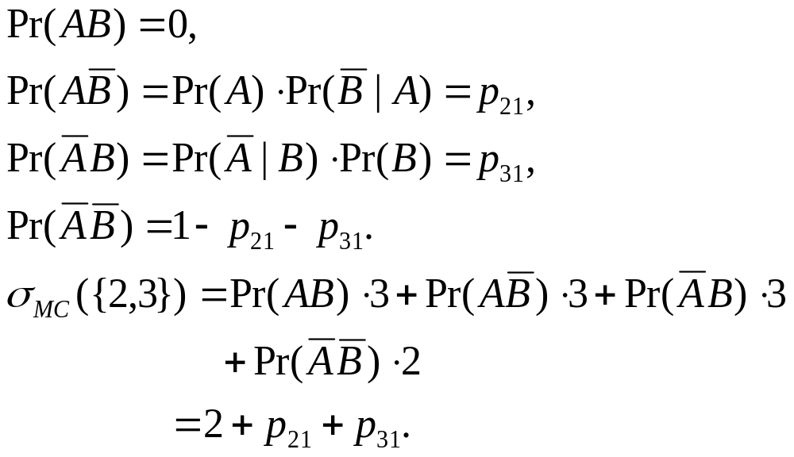
1
2
3

Slide 20
2nd Example
A property of LT=MC

Slide 21
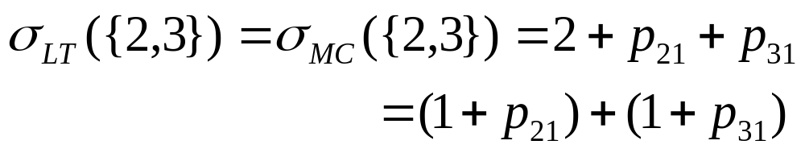
1
2
3
1
1
2
3

Slide 22



Equivalent Networks

Slide 23
Influence Maximization Problem
Influence spread of node set S: σ(S)
  expected number of active nodes at the end of diffusion process, if set S is the initial active set.
Problem Definition (by Kempe et al., 2003):
  (Influence Maximization). Given a directed and edge-weighted social graph G = (V,E, p) , a diffusion model m, and an integer k ≤ |V |, find a set S ⊆ V , |S| = k, such that the expected influence spread σm(S) is maximum.
Notes:
the influence of a set of nodes A: the expected number of active nodes at the end of the process.

Slide 24
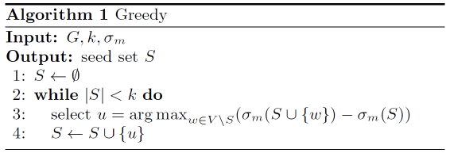
Known Results
Bad news: NP-hard optimization problem for both IC and LT models.
Good news:
σm(S) is monotone and submodular.
We can use Greedy algorithm!
Theorem: The resulting set S activates at least (1-1/e) (>63%) of the expected number of nodes that any size-k set could activate .

Slide 25
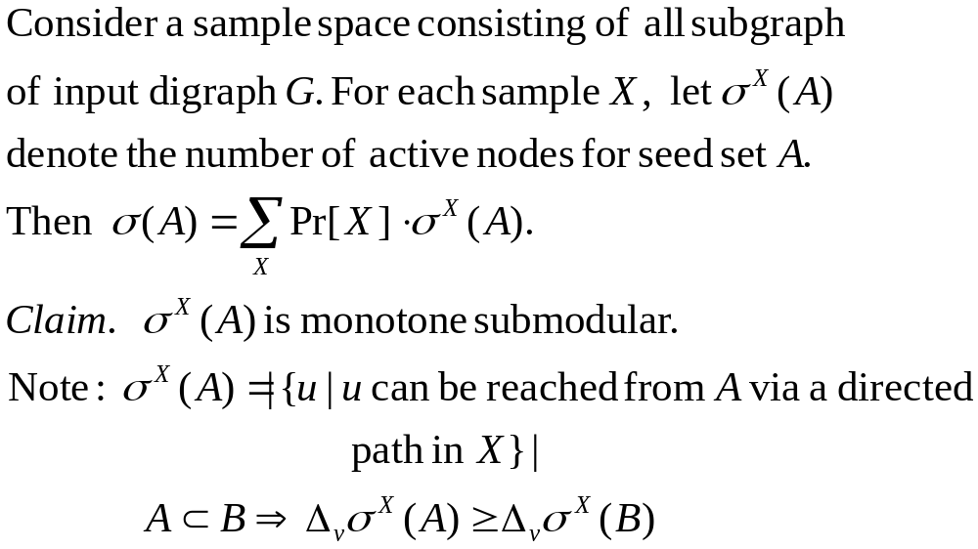
Proof of Submodularity

Slide 26
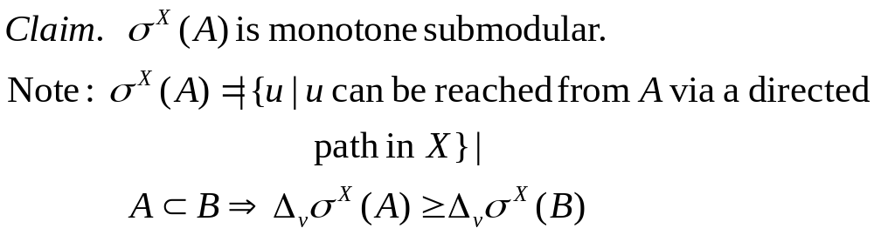




Slide 27
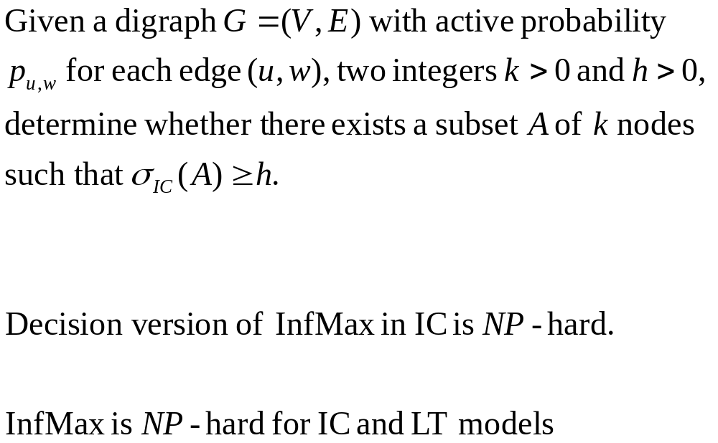
Decision Version of InfMax in IC
Is it in NP?
Theorem
Corollary

Slide 28
Disadvantage
Lack of efficiency.
  Computing σm(S) is # P-hard under both IC and LT models.
  Selecting a new vertex u that provides the largest marginal gain σm(S+u) - σm(S), which can only be approximated by Monte-Carlo simulations (10,000 trials).
Assume a weighted social graph as input.
  How to learn influence probabilities from history?
Notes:
( Step 3 of the Greedy algorithm above)

Slide 29
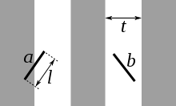
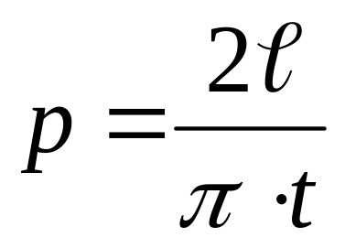
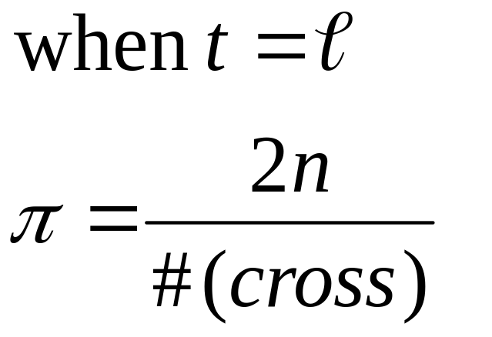
Monte-Carlo Method
Buffon's needle

Slide 30
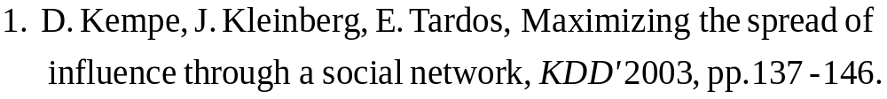
References

Slide 31
THANK YOU!

